Slide 1

Shaping the Future: How Education, Economy, and Policy Influence Life Expectancy and Fertility
Olivia Rueschhoff
Dr. Dinesh Ekanayake
Dr. Amy Ekanayake
Department of Mathematics
Undergraduate Research Day

Slide 2
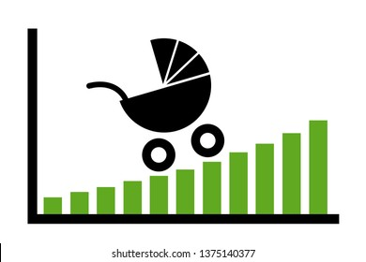
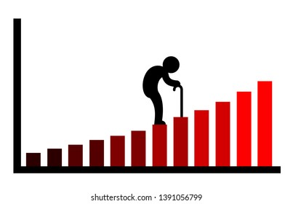
Life Expectancy and Fertility Rate
1960 – 2023
United States average
What we aim to predict
Life Expectancy is the average age someone in the US is expected to live till per year
Fertility Rate is the average number of children birthed per woman per year

Slide 3
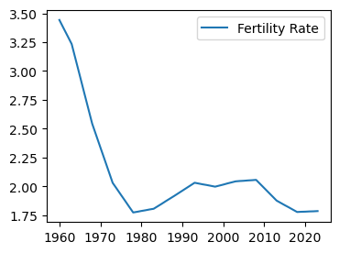
The Shifting Demographics: Rising Life Expectancy and Declining Fertility in the U.S.
Fertility rates have declined significantly over the past fifty years, dropping from 3.5 children per woman in 1959 to approximately 1.8 by 2020.
This long-term decline poses economic challenges by shrinking the working-age population and slowing growth.
Socially, it results in fewer adult children available to support aging parents, reshaping family dynamics and care structures.

Slide 4
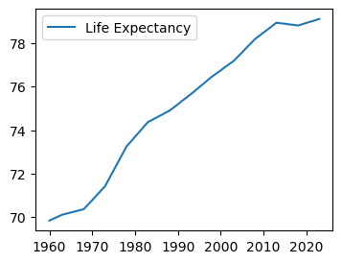
The Shifting Demographics: Rising Life Expectancy and Declining Fertility in the U.S.
Life expectancy has steadily risen from 69.9 years in 1959 to 78.9 years in 2020.
Leading to increased healthcare demands and a growing need for long-term care and support services for an aging population.

Slide 5
The Future of Aging and Fertility: Key Questions for the Next 50 Years
Where will our age demographics stand in 25 years? In 50? With a fertility rate already below the replacement level of 2.1 children per woman, how much lower will it drop—1.75? 1.5? And when? While immigration helps offset population decline, what factors could actively shift fertility trends?
Meanwhile, is life expectancy nearing a plateau in the coming decades? As societal norms evolve, will the definition of "young" and "young adult" change? Most critically, are we prepared to support a rapidly aging population in the next 25 to 50 years?
These questions shape the future of our economy, healthcare system, and social structures—making it essential to explore solutions today.

Slide 6
Two Key Research Priorities: Understanding and Forecasting Demographic Shifts
What Drives Demographic Change?
Which factors have the greatest influence on shifting demographics? In mathematical terms, which key indicators exhibit a consistent, monotonic relationship with fertility rates and life expectancy? Identifying these variables is crucial for understanding long-term trends.
How Can We Reliably Forecast the Next 25 to 50 Years?
To develop a highly robust and precise forecasting model, we must determine the optimal subset of variables that best predict demographic shifts. Once we establish such a model, we can not only project future outcomes based on current trends but also explore how adjusting key variables might alter the trajectory - offering insights into potential interventions.

Slide 7
Variables
Variable
Labor force participation rate among women aged 25–34
Percentage of people aged 25 and over with a bachelor's degree or higher
GDP per capita in the United States
Estimated total health expenditure as a percentage of Gross Domestic Product
Average educational expense per student
Average age at which women in the U.S. are getting married for the first time
Estimated contraceptive prevalence among women aged 15–49
Estimated number of abortions per 1000 pregnancies
It is rare to find a demographic forecasting model in the literature that simultaneously incorporates socio-demographic factors, education, behavioral patterns, and economic indicators.

Slide 8


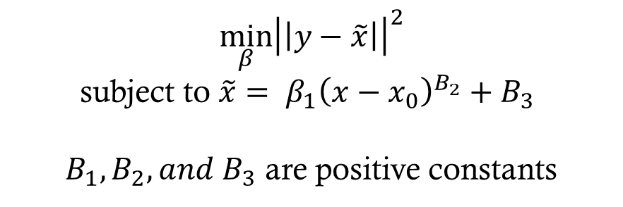
Variable Transformation
We apply transformations to variables with monotone relationships to achieve optimal linear correlation.
$$\min_{β}{{\left|\left|y−\tilde{x}\right|\right|}^{2}}$$
subject to $\tilde{x}= β_{1}{\left(x−x_{0}\right)}^{B_{2}}+B_{3}$
$B_{1}, B_{2}, and B_{3}$ are positive constants
No existing model applies transformations to
enhance performance.

Slide 9
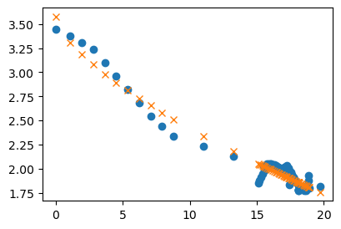
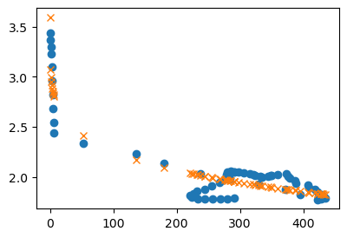


Contraceptive and Abortion Variables
Fertility Rate
Fertility Rate
Contraceptive
Abortion Rate
$$\tilde{x}=0.25{\left(x−48\right)}^{\text{0.}\text{6}\text{6}}+\text{3.}\text{5}\text{7}$$
$$\tilde{x}=0.56x^{\text{0.}\text{19}}+\text{3.}\text{60}$$

Slide 10
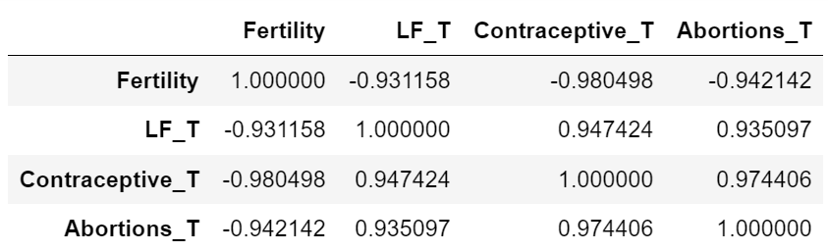

Pearson Linear Correlation

Slide 11
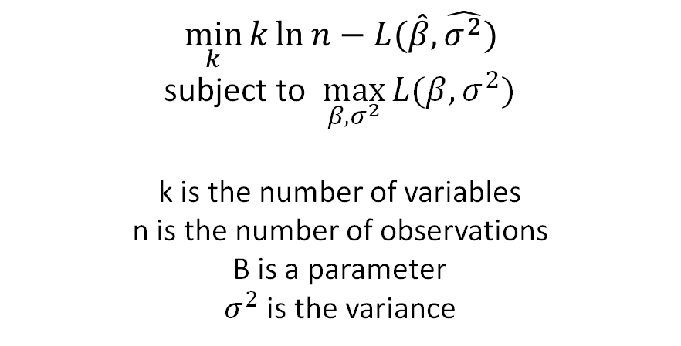
Variable Selection
We select variables by minimizing the Bayesian Information Criterion (BIC) across optimal linear models that maximize the likelihood function.
$$\min_{k}{k\ln{n}−L(\hat{β},\hat{σ^{2}})}$$
subject to $\max_{β,σ^{2}}{L(β,σ^{2})}$
k is the number of variables
n is the number of observations
B is a parameter
$σ^{2}$ is the variance

Slide 12
Testing Variables and Linear Models
Predictor | Variables | Adj R-Squared | Optimal BIC | Ljung-box | Heteroscedasticity
Fertility Rate | Bachelors for both genders, Education rate per pupil, Marriage age of women, transformed Women in Labor Force, and Contraceptive rate Transformed | 0.999 | -128.722 | 1.012 e-8 | 0.000019
Life Expectancy | Bachelor’s degree for both genders, Gross Domestic Product per capita, and transformed Women in the Labor Force | 0.999 | 190.964 | 2.611 e-12 | 0.000013

Slide 13
Vector autoregression model (VAR)
We use the VAR model to forecast time-dependent variables, fertility rates and life expectancy.
The model is trained on the first 33 years (1960–1992) and used to predict the subsequent 30 years to determine the maximum error.
Finally, we employ the model to forecast the next 50 years (2023–2073).

Slide 14
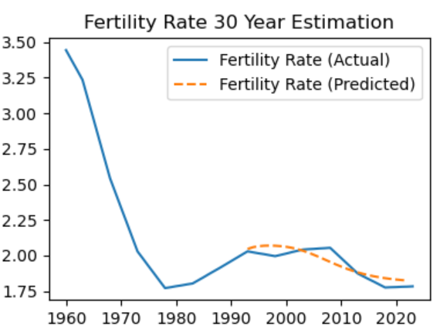
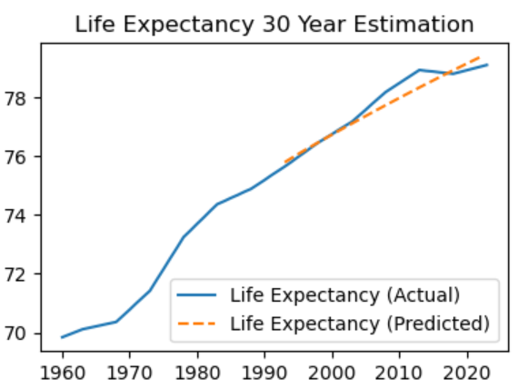
Error in Predicting Our Known 30 years
Predictor | Max Relative Error | Max Percentage Error | Max Absolute Error
Fertility | 0.040 | 4.019% | 0.082
Life Expectancy | 0.009 | 0.904% | 0.714

Slide 15
Final Testing to Confirm Best model
The VAR model captures fertility rate dynamics well, with strong residual diagnostics. While some volatility is present, the model remains strong for forecasting fertility trends.
The VAR model for life expectancy is statistically sound and well-suited for forecasting, despite mild volatility in residuals.
Test | Fertility Rate | Life Expectancy
Normality Assumption | 0.553 | 0.563
No Autocorrelation | (lags 1–3) > 0.17 | (lags 1–3) > 0.6
Heteroscedasticity | 0.0037 | 0.0416

Slide 16

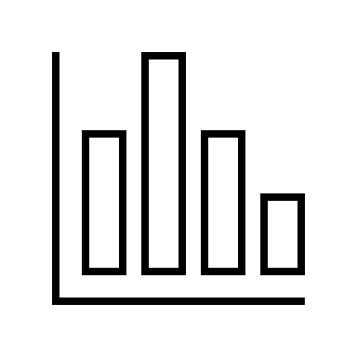
Predicting The next 50 Years
50-year forecast of Fertility Rate:
1.786493, 1.789515, 1.790966, … 1.640763, 1.636120, 1.631463, 1.626789, 1.622093
Fertility Rate will reach 1.75 by 2047.
50-year forecast of Life Expectancy:
79.196899, 79.311067, 79.446003, … , 83.855930, 83.935940, 84.015404, 84.094327, 84.172714
Life expectancy will reach around 84 after 50 years from now.
According to the Penn Wharton Budget Model, it is expected to decline to approximately 1.6 by the 2060s. Our model forecasts a rate of 1.65 by 2065.
According to the Institute for Health Metrics and Evaluation, life expectancy in the U.S. is projected to rise by 1.6 years between 2023 and 2035. Our predictions estimate increase of 1.7 years during the same interval.

Slide 17

Conclusion
Using Vector Autoregressive (VAR) modeling, we effectively analyzed and forecasted trends in fertility rates and life expectancy over time.
Residual diagnostics validated the strong statistical performance of both models, showing normal distribution and low autocorrelation.
Despite some detected heteroscedasticity, the models remain robust and highly reliable for both short-term and long-term predictions.
These findings provide valuable insights to support informed decision-making in public health planning and demographic analysis moving forward.

Slide 18
Data References
Johnston, W. R. (2023, January 29). U.S. expenditures for defense and education, 1910–2021. National Defense Budget Estimates &
Department of Education. https://www.johnstonsarchive.net/policy/edgraph.html
MacroTrends. (n.d.). U.S. Fertility Rate 1950–2025. United Nations - World Population Prospects. https://www.macrotrends.net/global-
metrics/countries/usa/united-states/fertility-rate
MacroTrends. (n.d.). U.S. Life Expectancy 1950–2025. United Nations - World Population Prospects.
https://www.macrotrends.net/global-metrics/countries/usa/united-states/life-expectancy
U.S. Census Bureau. (2023, February 9). Table A-1. Years of School Completed by People 25 Years and Over, by Age and Sex: Selected Years 1940
to 2022. CPS Historical Time Series Tables. https://www2.census.gov/programs-surveys/cps/techdocs/cpsmar22.pdf
U.S. Department of Labor. (2024, December). Labor force participation rate of women by age. U.S. Bureau of Labor Statistics, Current
Population Survey. https://www.dol.gov/agencies/wb/data/lfp/women-by-age
World Bank. (2021). Contraceptive prevalence (% of women ages 15–49). Household Surveys, UN Population Division.
https://genderdata.worldbank.org/en/indicator/sp-dyn-zs?view=trend&geos=USA#data-table-section
World Bank. (2023). GDP per capita (constant 2015 USD). World Bank Gender Data Portal.
https://data.worldbank.org/indicator/NY.GDP.PCAP.KD

